Slide 1
Introduction to NLP
5. Sequence Models
Dr. John McCrae
Data Science Institute, University of Galway

Slide 2
Language
Models

Slide 3
Spelling correction
“I will be there in five minuts”
minuets
minutes

Slide 4
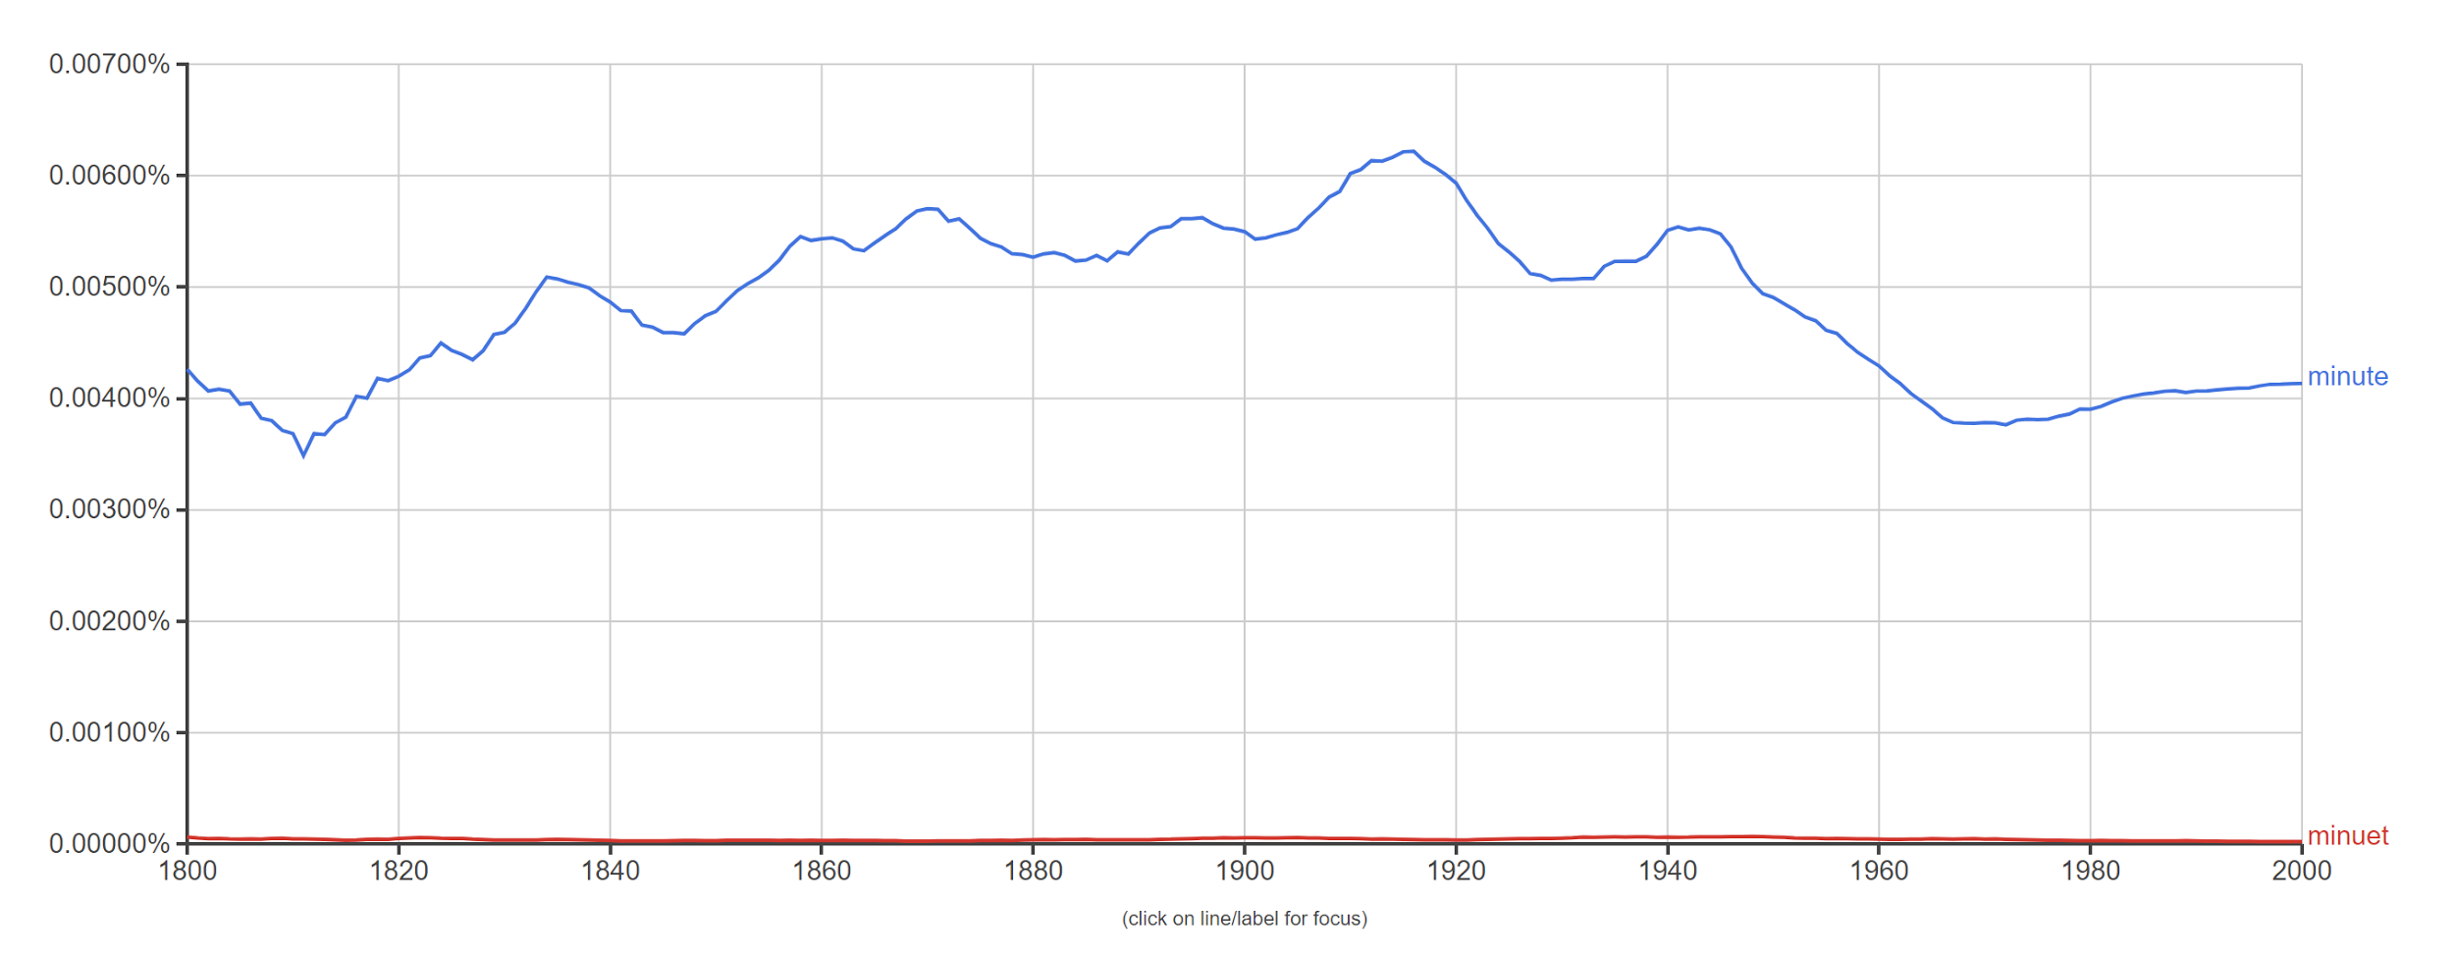
Spelling correction

Slide 5


Translation probability
Band
ribbon
band
volume

Slide 6
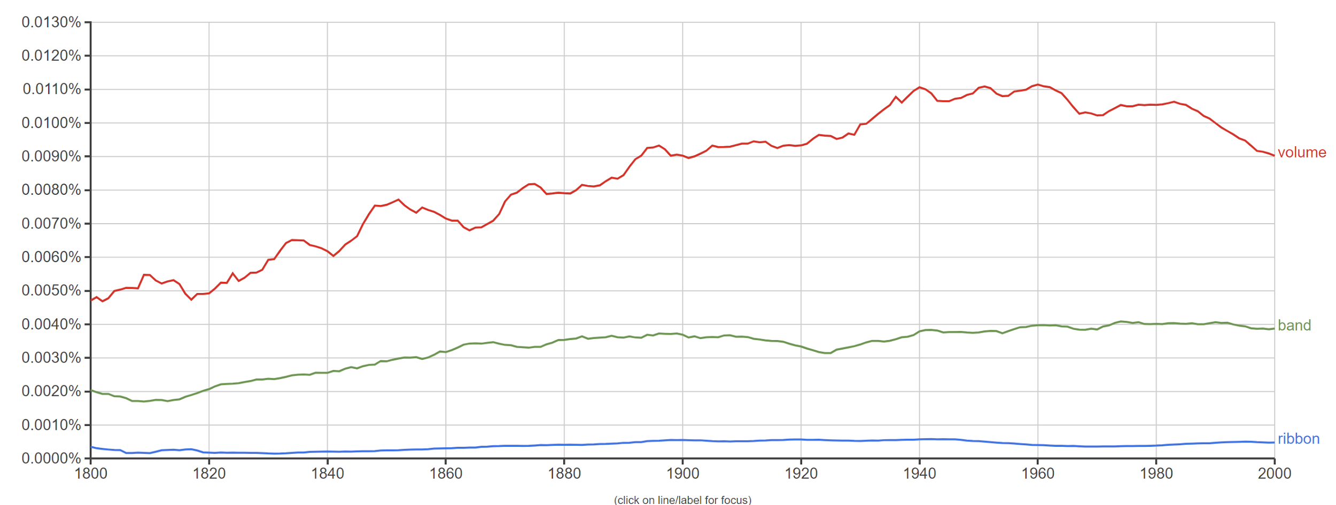
Translation Probability

Slide 7
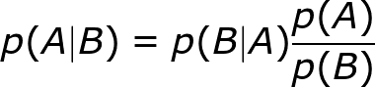
Conditional Probability
What we really need is:
p(“volume”@en | “Band”@de)
Definition of conditional probability
p(A|B)p(B) = p(A∩B)
Recall Bayes’ Law

Slide 8
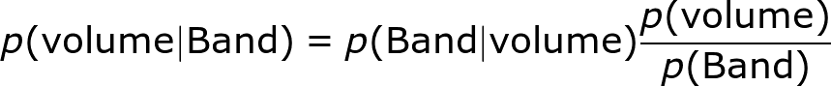
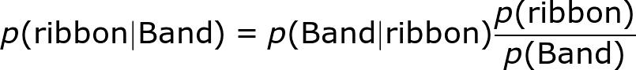

Noisy Channel Model
We can treat p(Band) as a constant

Slide 9
n-gram Models

Slide 10
Probability of a sentence
p(“I like green eggs”) is the probability of the intersection of 4 events:
p(w₁=”I”∩w₂=”like”∩w₃=”green”∩w₄=”eggs”)
This can be hard to estimate for long sentences

Slide 11
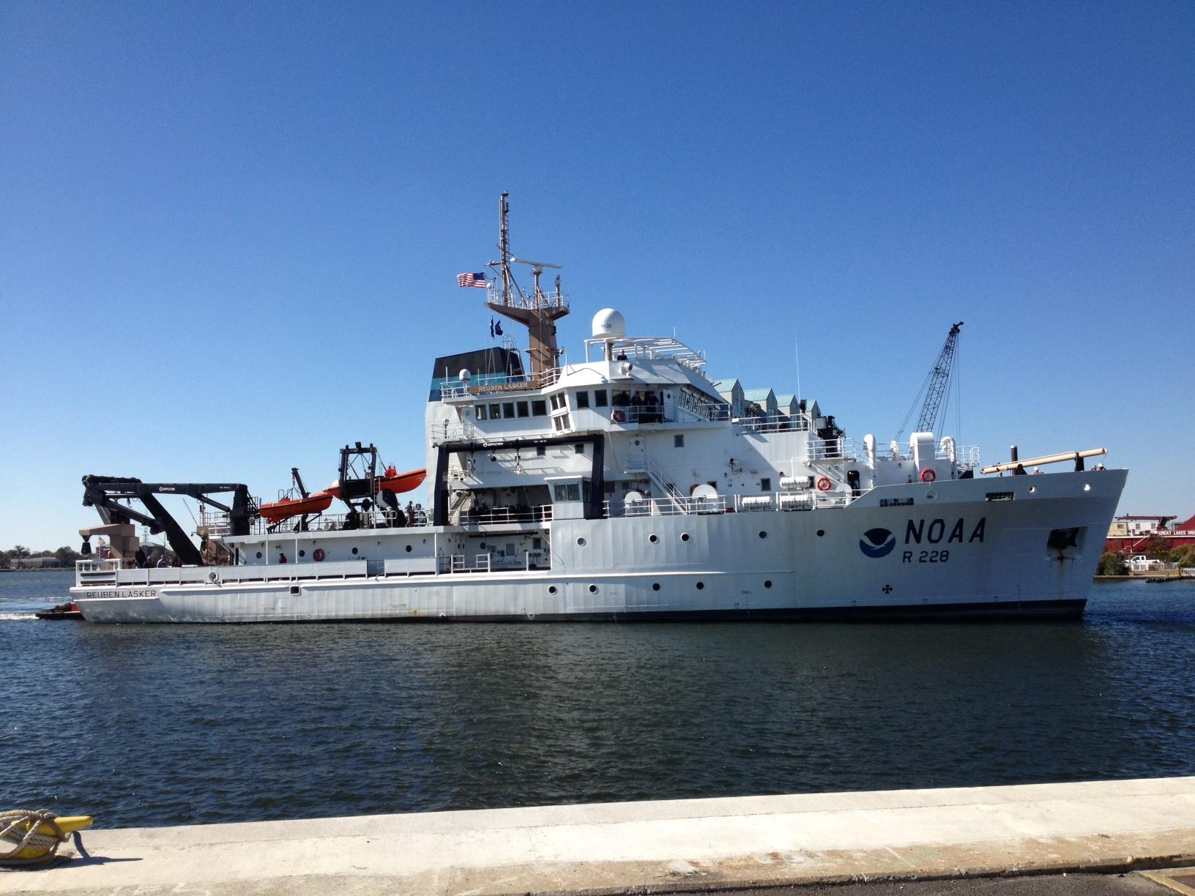
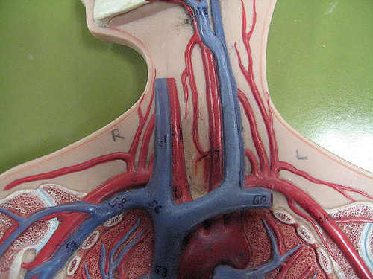

Context
fishing vessel
blood vessel
copper vessel

Slide 12

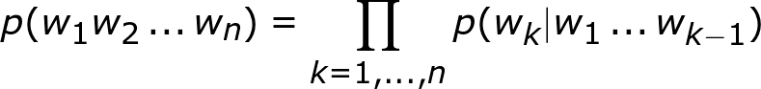
Probability of a sentence (language modelling)
Recalling the definition of conditional probability
Hence by induction
IMPORTANT: Note the order here. e.g.,
p(w₄|w₁w₂w₃)

Slide 13
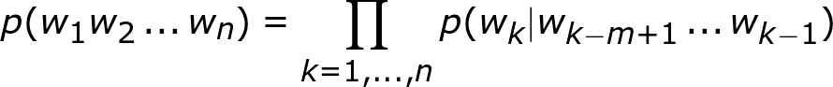
N-gram approximation
As seen already ‘data sparsity’ is a major issue, this is nearly impossible for long-sequences of words (n-grams)
Solution: Approximate using a fixed window of previous words
1-gram = unigram
2-gram = bigram
3-gram = trigram
4-gram = four-gram
etc.
Look back only m - 1 words

Slide 14
Example corpus
Do you like green eggs and ham?
I do not like them, Sam-I-am.
I do not like green eggs and ham.
Would you like them here and there?
I would not like them here or there.
I would not like them anywhere.
I do not like green eggs and ham.
I do not like them Sam-I-am.

Slide 15
Unigram probabilities
and | 4 | like | 8
anywhere | 1 | not | 6
do | 5 | or | 1
eggs | 3 | Sam-I-am | 2
green | 3 | them | 5
ham | 3 | there | 2
here | 2 | would | 3
I | 6 | you | 2
and | 0.07 | like | 0.14
anywhere | 0.02 | not | 0.11
do | 0.09 | or | 0.02
eggs | 0.05 | Sam-I-am | 0.04
green | 0.05 | them | 0.09
ham | 0.05 | there | 0.04
here | 0.04 | would | 0.05
I | 0.11 | you | 0.04
sum=56

Slide 16
Bigram counts
and there | 1 | here or | 1 | them Sam-I-am | 2
and ham | 3 | I do | 4 | them here | 2
do you | 1 | I would | 2 | them anywhere | 1
do not | 4 | like green | 3 | would you | 1
eggs and | 3 | like them | 5 | would not | 2
green eggs | 3 | not like | 6 | you like | 2
here and | 1 | or there | 1

Slide 17
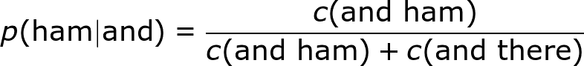
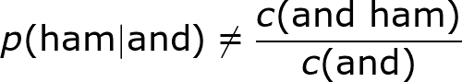
Bigram probabilities
Do not do the following. It is not correct. Why?

Slide 18
Bigram probabilities
p(there|and) | 0.25 | p(or|here) | 0.50 | p(Sam-I-am|them) | 0.40
p(ham|and) | 0.75 | p(do|I) | 0.67 | p(here|them) | 0.40
p(you|do) | 0.20 | p(would|I) | 0.33 | p(anywhere|them) | 0.20
p(not|do) | 0.80 | p(green|like) | 0.38 | p(you|would) | 0.33
p(and|eggs) | 1.00 | p(them|like) | 0.62 | p(not|would) | 0.67
p(eggs|green) | 1.00 | p(like|not) | 1.00 | p(like|you) | 1.00
p(and|here) | 0.50 | p(there|or) | 1.00

Slide 19
Applying bigram probabilities
p(“would you like green eggs and ham”)
≅ p(“would”) × p(“you”|”would”) × p(“like”|”you”) × p(“green”|”like”) × p(“eggs”|”green”) × p(“and”|”eggs”) × p(“ham”|”and”)
= 0.05 × 0.33 × 1.0 × 0.38 × 1.0 × 1.0 × 0.75
= 0.0047

Slide 20
Exercise
Spelling Correction

Slide 21
Tagging Models

Slide 22
Conditional Probabilities
We can express this in terms of conditional probabilities
p(“I like green eggs”) =
p(“eggs”|”I like green”) ×
p(“green”|”I like”) ×
p(“like”|”I”) ×
p(“I”)

Slide 23
N-gram approximations
We can express this in terms of conditional probabilities
p(“I like green eggs”) ≈
p(“eggs”|”green”) ×
p(“green”|”like”) ×
p(“like”|”I”) ×
p(“I”)

Slide 24
Syntax
Goal of a language model is to predict whether a sentence is in English (or another language)
Syntax is important
Correct: Happy children play (Adj Noun Verb)
Incorrect: Children happy play (Noun Adj Verb)
Trees next week

Slide 25
Tags as probabilities
We now have two kinds of events:
p(w₁=”happy”∩w₂=”children”∩w₃=”play”
∩t₁=Adj∩t₂=Noun∩t₃=Verb)
This is not possible to calculate for long sentences => Approximation

Slide 26
Bayes’ Law for tagging
p(w₁,w₂,w₃,t₁,t₂,t₃) =
p(w₃|t₃,t₂,t₁,w₁,w₂) ×
p(t₃|t₂,t₁,w₁,w₂) ×
p(w₂|t₂,t₁,w₁) ×
p(t₂|t₁,w₁) ×
p(w₁|t₁) ×
p(t₁)

Slide 27
Hidden Markov Model
p(w₁,w₂,w₃,t₁,t₂,t₃) ≈
p(w₃|t₃) ×
p(t₃|t₂) ×
p(w₂|t₂) ×
p(t₂|t₁) ×
p(w₁|t₁) ×
p(t₁)

Slide 28
Hidden Markov Model
p(t₁|t₀)
p(t₂|t₁)
p(t₃|t₂)
t₀
t₁
t₂
t₃
p(w₁|t₁)
p(w₂|t₂)
p(w₃|t₃)
w₁
w₂
w₃

Slide 29
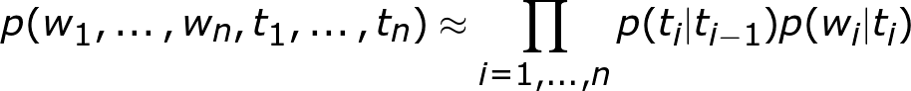
Hidden Markov Model
The general form for this is:
We introduce a variable t₀ which always has the same value (‘START’)

Slide 30
Example
 | V | N
Start | 0.2 | 0.8
V | 0.4 | 0.6
N | 0.6 | 0.4
 | John | likes | Mary
V | 0.2 | 0.6 | 0.2
N | 0.4 | 0.2 | 0.4
P(“John Likes Mary”, “N V N”)
= P(N|Start) × P(V|N) × P(N|V) × P(John|N) × P(likes|V) × P(Mary|N)
= 0.8 × 0.6 × 0.6 × 0.4 × 0.6 × 0.4

Slide 31

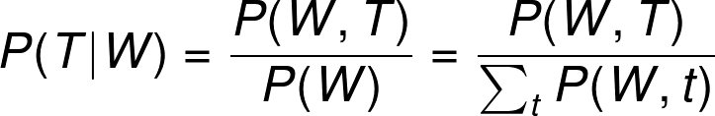
Conditional Random Fields
HMMs are limited - only look back one word at a time
Let’s simplify the notation
We can use any approximations or method as follows
This general form is called a conditional random field.
Notes:
P(W, T) = P(w_1,\ldots w_n, t_1, \ldots t_n)

Slide 32
Estimating most likely tagging
How do we find the most likely tags for a sequence?
 | John | likes | Mary
V | 0.5 | 0.4 | 0.1
N | 0.1 | 0.5 | 0.4
p(“John likes”, “N N”) = 0.8×0.1×0.5×0.5
p(“John likes”, “N V”) = 0.8×0.1×0.5×0.4
So “likes” is a N?
No!
p(“John likes Mary”, “N N N”) = 0.8×0.1×0.5×0.5×0.5×0.4
p(“John likes Mary”, “N V N”) = 0.8×0.1×0.5×0.4×0.9×0.4
 | V | N
Start | 0.2 | 0.8
V | 0.1 | 0.9
N | 0.5 | 0.5
The most likely subsequence is not necessarily part of the most likely full sequence

Slide 33
Find the best tagging (brute force)
If S={V,N}, what is the most likely tagging of “cats drink”?
p(N,N,cats,drink) = p(N|Start) × p(N|N) × p(cats|N) × p(drink|N)
p(N,N,cats,drink) | 0.023
p(N,V,cats,drink) | 0.034
p(V,N,cats,drink) | 0.017
p(V,V,cats,drink) | 0.021
Complexity is O(TN^{T})

Slide 34
Solving HMMs and CRFs
Viterbi and dynamic programming are used to solve these models
Polynomial time (for HMMs and many CRFs)
These are trained (probability inference) on tagged corpora

Slide 35
Exercise
Part-of-speech tagging

Slide 36
Applications

Slide 37
Single-word classifiers
Alternative is to use an individual classifier
Pros:
Low complexity
Cons:
Independent results may be inconsistent
Needs more context (expensive)
Independent Classifier
w_{n-2}
w_{n-1}
w_{n}
w_{n+1}
w_{n+2}
Transformers

Slide 38
Recurrent Models
Tag Prediction
Tag Prediction
Tag Prediction
Classifier
Context Prediction
Classifier
Context Prediction
Classifier
Context Prediction
More on this in three weeks!
w_{n-1}
w_{n}
w_{n+1}

Slide 39
Error Detection
We can use tagging to find spelling/grammar errors
OK
Misspelled
OK
Ungrammatical
Is thsi really correctly?

Slide 40
Named Entity Recognition
Named entity recognition identifies places, people, organizations and dates in text
Annotated with IOB annotation (I=In NE, O=Out of NE, B=Begin of NE)
B-Loc
I-Loc
O
B-Org
O
O
O
O
Hong Kong where Evergrande has its main listing

Slide 41
Sequence Generation
We can also generate text… use the next word as the tag!
We then repeatedly generate the next word based on the prediction.
Kong
where
Evergrande
has
its
main
listing
</s>
Hong Kong where Evergrande has its main listing

Slide 42
Machine Translation
This can gives us a (simple) model for machine translation
Special symbol to indicate the translation language
is
hard
@@DE@@
Übersetzung
Translation is hard @@DE@@

Slide 43
Questions?

